Slide 1
1
Department of Life Safety
“Status of work accidents in food industry of Ukraine”
© О. Evtushenko, І. Klepikov, 2013
Notes:
1

Slide 2
Statistical analysis of
accidents in food industry enterprises
2
Aim of research
Object of research :
SUBJECT OF RESEARCH :
Occupational injuries at the food industry enterprises
Influence of accident reasons and circumstances on the Labor Protection state
STATISTICAL METHOD
(allows to determine the quantitative aspect of injury and explore its’ basic reasons and patterns by a large number of factors)
METHODS OF RESEARCH
Data for analysis was taken
from acts by formН-1 and
from reports by form №7-ТНВ
MATERIALS OF RESEARCH

Slide 3
For achieve a purpose of research this particular tasks were solved:
3
Dynamic analysis of occupational injury with lethal consequences and without in food industry.
Analysis of accidents with lethal consequences by sort of events and reasons of injury at food industry enterprises.
Analysis of accidents with lethal consequences by workers’ profession groups, age and work experience.
Analysis of accidents with lethal consequences which happened with workers during: studying and instructing, period from studying until accident, for period from last instructing until accident, by professional groups of employee who violated the Labor Safety law and cause the accident.
Background characteristics of research
We study the food industry enterprises
(Determining the reasons and circumstances of occupational injury typical for food branch)
Research limitation
Occupational injury status at enterprises of food industry for 2003…2011 period

Slide 4
Statistical analysis of occupational injury at food industry enterprises
4
CALCULATED RATES OF OCCUPATIONAL INJURY IN FOOD INDUSTRY OF UKRAINE, 2003-2011 PERIOD
Occupational injuries indexes | Years
 | 2003 | 2004 | 2005 | 2006 | 2007 | 2008 | 2009 | 2010 | 2011
Frequency of injury coefficient C_{f} | 3,7 | 2,8 | 3,4 | 2,7 | 2,1 | 1,9 | 1,4 | 1,4 | 1,2
Partial loss of working capacity coefficient C_{plwc} | 0,191 | 0,069 | 0,159 | 0,052 | 0,057 | 0,038 | 0,037 | 0,044 | 0,036
Injury heaviness coefficient C_{ih} | 26,3 | 28,1 | 29,7 | 29,4 | 33,6 | 36,8 | 38,8 | 39,1 | 47,2
Dynamic of occupational injury in food industry of Ukraine, 2003-2011 period

Slide 5
5
Statistical analysis of occupational injury among food industry workers
Dynamic of injured male and female workers in food industry of Ukraine, 2003-2011 period
Dynamic of deadly injured male and female workers in food industry of Ukraine, 2003-2011 period
Comparative growth dynamic of inoperability man-days per one injured at work in food industry of Ukraine, 2003-2011 period.
Comparative growth dynamic of inoperability man-days per one injured at work in food industry of Ukraine, 2003-2011 period

Slide 6
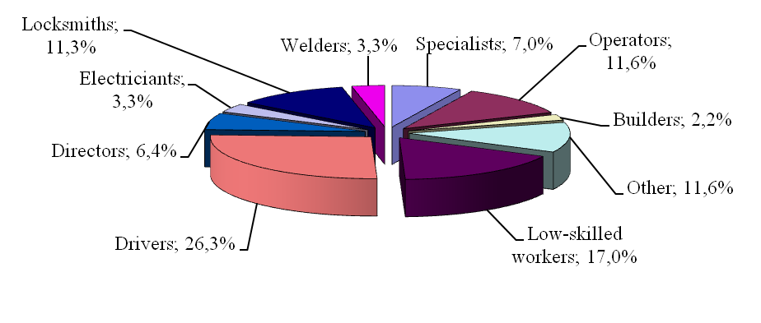
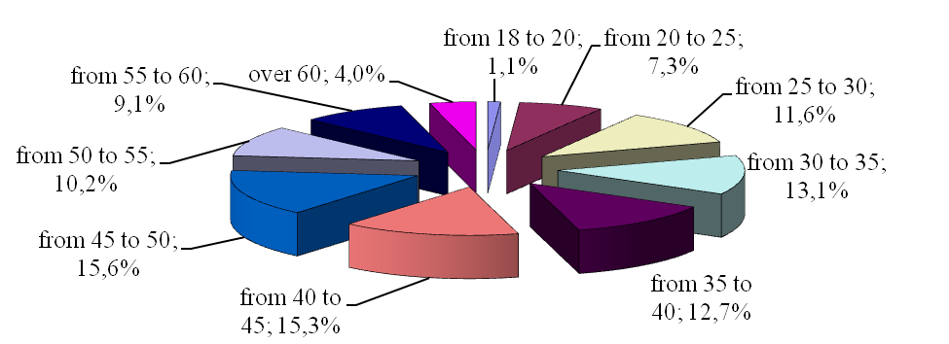
System data analysis of occupational injury among food industry workers
6
Splitting of specific weight of dead workers by the experience in Food Industry for 2000-2011 period
Years range | Work experience, years
 | Total | By profession
Less than 1 year | 4,4 | 29,8
From 1 to 3 | 3,6 | 23,6
From 3 to 5 | 3,6 | 7,6
From 5 to 10 | 10,2 | 12
Вiд 10 до 15 | 12,7 | 10,2
From 15 to 20 | 14,2 | 6,2
Over 20 | 51,3 | 10,5
Dividing of deadly injured employees of Food Industry by the profession groups in 2000-2011
Dividing of deadly injured workers of Food Industry by the age in 2000-2011.

Slide 7
Statistical data analysis by sorts of events that causes accidents at food industry enterprises
7
7
Dividing of dead by the accidents of occupational injury in Food Industry in 2000-2011.
Types of accidents | Percent
Transport accidents | 34,6
Falling of injured | 17,5
Including the:
Falling from height | 10,2
Falling during the move | 3,6
Falling, collapse, ruing of objects, materials and other | 9,5
Influence of outfit and details that move | 11,6
Including the:
influence of outfit and details that move, fly and spinning | 7,3
Electric Shock | 5,5
Including the:
Touch to the power line and broken wires | 1,8
Extreme temperature effects (except fire) | 2,9
Effect of hazardous and toxic substances | 4,4
Drowning | 0,4
Asphyxia | 1,8
Murder or injury caused by another person | 1,8
Natural disaster | 0,4
Fire | 2,5
Explosion | 3,6
Other types | 3,5

Slide 8
Statistical data analysis of accident reasons at food industry enterprises
8
8
Dividing of dead by the reasons of occupational injury in Food Industry for 2000-2011.
Accident reason | Percent
Technical
Constructive drawbacks, imperfection, low reliability of capital goods | 5,4
Constructive drawbacks, Imperfection, low reliability of transport | 0,3
Low quality of development or absence of the project documentation for construction, reconstruction of production objects, buildings, etc. | 2,7
Imperfection, mismatch between the security requirements of technological process | 4,2
Poor technical condition of production facilities, buildings, structures, territory | 3,9
Poor condition of the capital goods | 3,3
Poor condition of the transport | 2,4
Poor condition of the working environment | 0,3
Organizational
Unsatisfactory functioning or absence of labor protection system | 5,4
Drawbacks during study of working safety methods | 12,9
Unsatisfactory of creating, imperfection or absence of labor protection instructions | 0,6
Absence of labor protection duties in job instructions | 0,6

Slide 9
Statistical data analysis of accident reasons at food industry enterprises
9
Dividing of dead by the reasons of occupational injury in Food Industry for 2000-2011.
Violation of work and rest regime | 0,9
Absence or poorly medical survey (professional selection) | 0,9
Unused personal protection in fact of its’ absence | 1,2
Work with switched off, broken collective protection devices, alarm systems, ventilation | 1,2
Using of workers with another profession | 0,3
Violation of technological process | 1,2
Safety violation during the operation of machines, mechanisms etc. | 4,5
Violation of safety rules during the transport using | 3,6
Traffic infraction | 16,2
Disuse of personal protection (if you have it) | 3,6
Disuse of collective protection | 0,3
Violation of labor and production discipline | 16,8
Psychophysical
Alcohol, drug, toxic intoxication | 3
Poor physical and health | 0,3
Injury as a result of wrongful act of another person | 1,2
Other reasons | 2,8

Slide 10
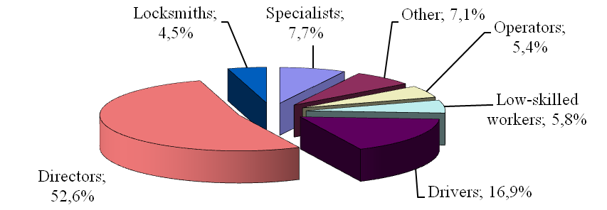
Statistical data analysis of accident reasons at food industry enterprises
10
Dividing of total number of deadly injured workers in food industry, for 2003-2011 period, for the studying and instructing period.
Instructing | Studying by profession or work | First Instructing | Second Instructing
Carried | 49 | 81,3 | 81,3
Not carried | 30,8 | 13 | 11,5
Not required | 9,1 | 0 | 3,4
No info | 11,1 | 5,7 | 3,8
Splitting by the profession groups of persons who committed labor safety law violation with accidents in Food Industry for 2000-2011 period.
Dividing of total number of deadly injured workers in food industry, for 2003-2011 period, from the studying period of kind of work until accident.
Dividing of total number of deadly injured workers in food industry, for 2003-2011 period, from the last instructing until accident.
Notes:
10

Slide 11
CONCLUSIONS
11
1The results of research shows, that in food industry of Ukraine during 2003-2011 the number of work accidents was decreased almost in 4 times.
Female workers are traumatized in 2 times less than are male workers. The frequency of injuries decreased, but the severity of injuries is still high. That means, the accidents became more dangerous.
2. Big number of injured workers with service record over the 20 years, and for employee with less than 1 year of experience. Above a half of accidents was caused by a different level directors who violated the labor protection law. We should to pay special attention during the primary and second instructing on the workplace. Besides, it is necessary to improve quality of instructing, intensify the control for low-skilled workers. It is necessary to enlarge the responsibility of all level directors on branch enterprises with aim to prevent the labor safety law violation which leads to work accidents.
3.By the statistical analysis we found out that organizational (Violation of work and rest regime, Unused personal protection in fact of its’ absence, Violation of labor and production discipline) and qualification factors are reasons of 72% occupational injury in food industry.
4 . During the statistical analysis of food industry enterprises we identified next negative factors : lack of automation system for recording and analysis of accidents in the food industry, lack of information speed about accidents in food industry, not taken into account the relationship between accident causes and circumstances, not taken into account the risk of injury resulting in accidents.

Slide 12
THANKS FOR ATTANTION!

